Slide 1

Unveiling Global Health Disparities
A Data Science Capstone Project on Income, Health, and Population Dynamics

Slide 2
Project Overview
Agenda: Navigating Our Capstone Journey
1
2
Introduction & Problem
Methodology
Defining the core question and its significance.
Our approach: data preparation, analysis, and model selection.
3
4
Key Findings
Recommendations & Future Work
Unveiling the relationships within global health data.
Translating insights into actionable strategies and next steps.

Slide 3

I. Project Introduction
The Global Health Conundrum
Research Question: What is the relationship between Income, Health (e.g., life expectancy, mortality rates), and Population size across different countries?
This project investigates the intricate interplay of socio-economic factors and health outcomes on a global scale. Understanding these relationships is crucial for targeted interventions and policy-making to reduce health disparities.

Slide 4
II. Methodology
Data Acquisition & Preparation
Our analysis leverages comprehensive global datasets. Rigorous preprocessing ensured data quality and consistency.
Dataset Identification
Cleaning & Transformation
Dataset Title: World Health & Economic Indicators
Missing Values: Imputation using statistical methods (mean, median) or advanced techniques (k-NN).
Source: World Bank, WHO, and UN Data Repositories (Combined for comprehensive coverage)
Outliers: Identification and treatment via Winsorization or robust scaling to minimize skew.
Structure: Predominantly structured (CSV, APIs)
Status: Requires extensive preprocessing
Data Transformation: Log transformation for skewed income data; Min-Max scaling for health metrics.
Feature Engineering: Creation of new features like "Healthcare Spending per Capita" from existing data.

Slide 5




II. Methodology (Continued)
Python Analytics: EDA & Modeling
Python's robust libraries facilitated in-depth exploratory analysis and sophisticated model application.
Exploratory Data Analysis (EDA)
Machine Learning Model
Descriptive statistics for each variable; correlation matrices to uncover relationships; visualizations (histograms, scatter plots, box plots) to understand distributions and potential outliers.
Selected Model: Random Forest Regressor, chosen for its ability to handle non-linear relationships and feature importance insights. (Alternative: Gradient Boosting Machines for comparison).
Model Evaluation
Code Structure & Innovation
Metrics: R-squared, Mean Absolute Error (MAE), and Root Mean Squared Error (RMSE) to assess predictive accuracy. Cross-validation to ensure robustness.
Modular functions for data pipeline; comprehensive markdown explanations; custom feature selection (e.g., recursive feature elimination) for innovation.

Slide 6
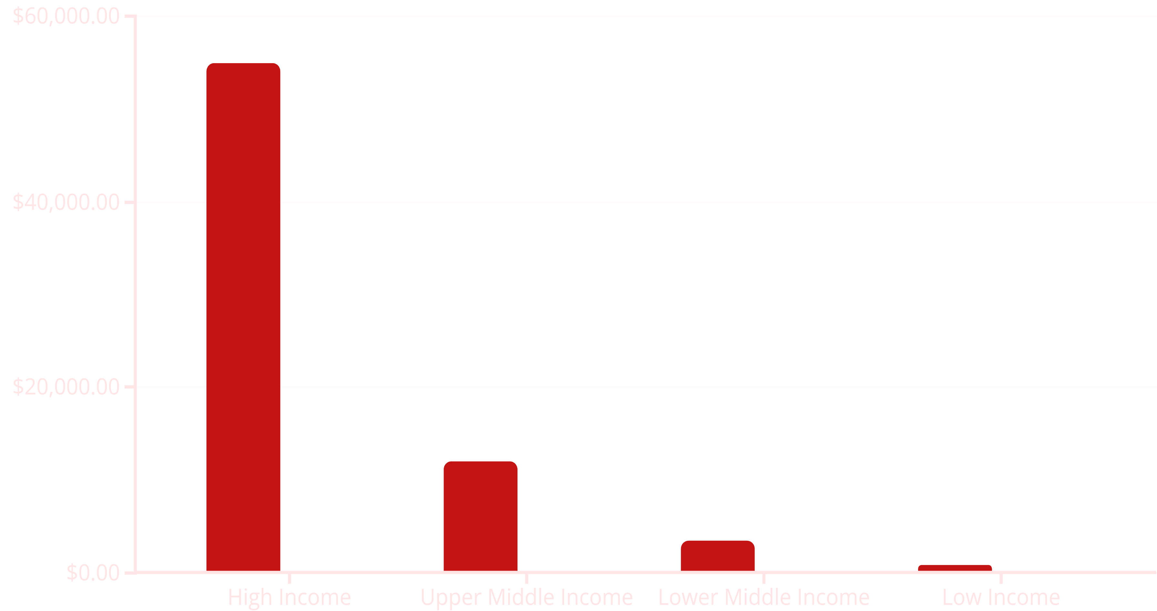
III. Key Findings
Income & Health: A Clear Correlation
GDP per Capita (USD)
Life Expectancy (Years)
Our analysis reveals a strong positive correlation between a country's GDP per capita and its average life expectancy. Higher income generally corresponds to better health outcomes, indicating access to healthcare, nutrition, and education.

Slide 7
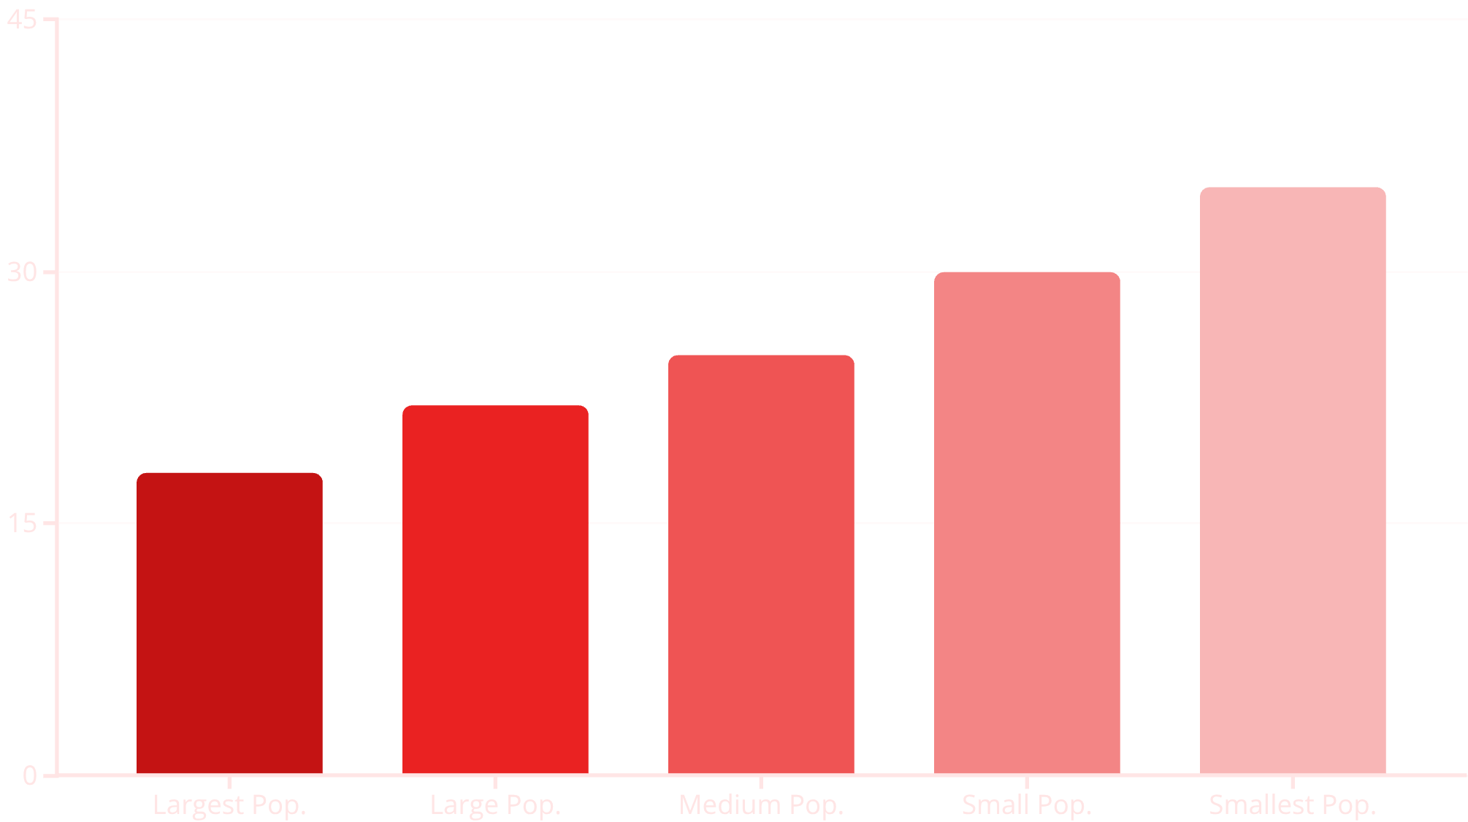
III. Key Findings (Continued)
Population Dynamics & Health Metrics
While less direct than income, population size also exhibits interesting patterns in relation to health indicators.
Larger populations often present challenges in equitable resource distribution, potentially impacting health indicators such as infant mortality rates. However, this is heavily moderated by income levels.
Observation: Smaller, high-income countries often exhibit the best health outcomes, benefiting from focused resource allocation.

Slide 8
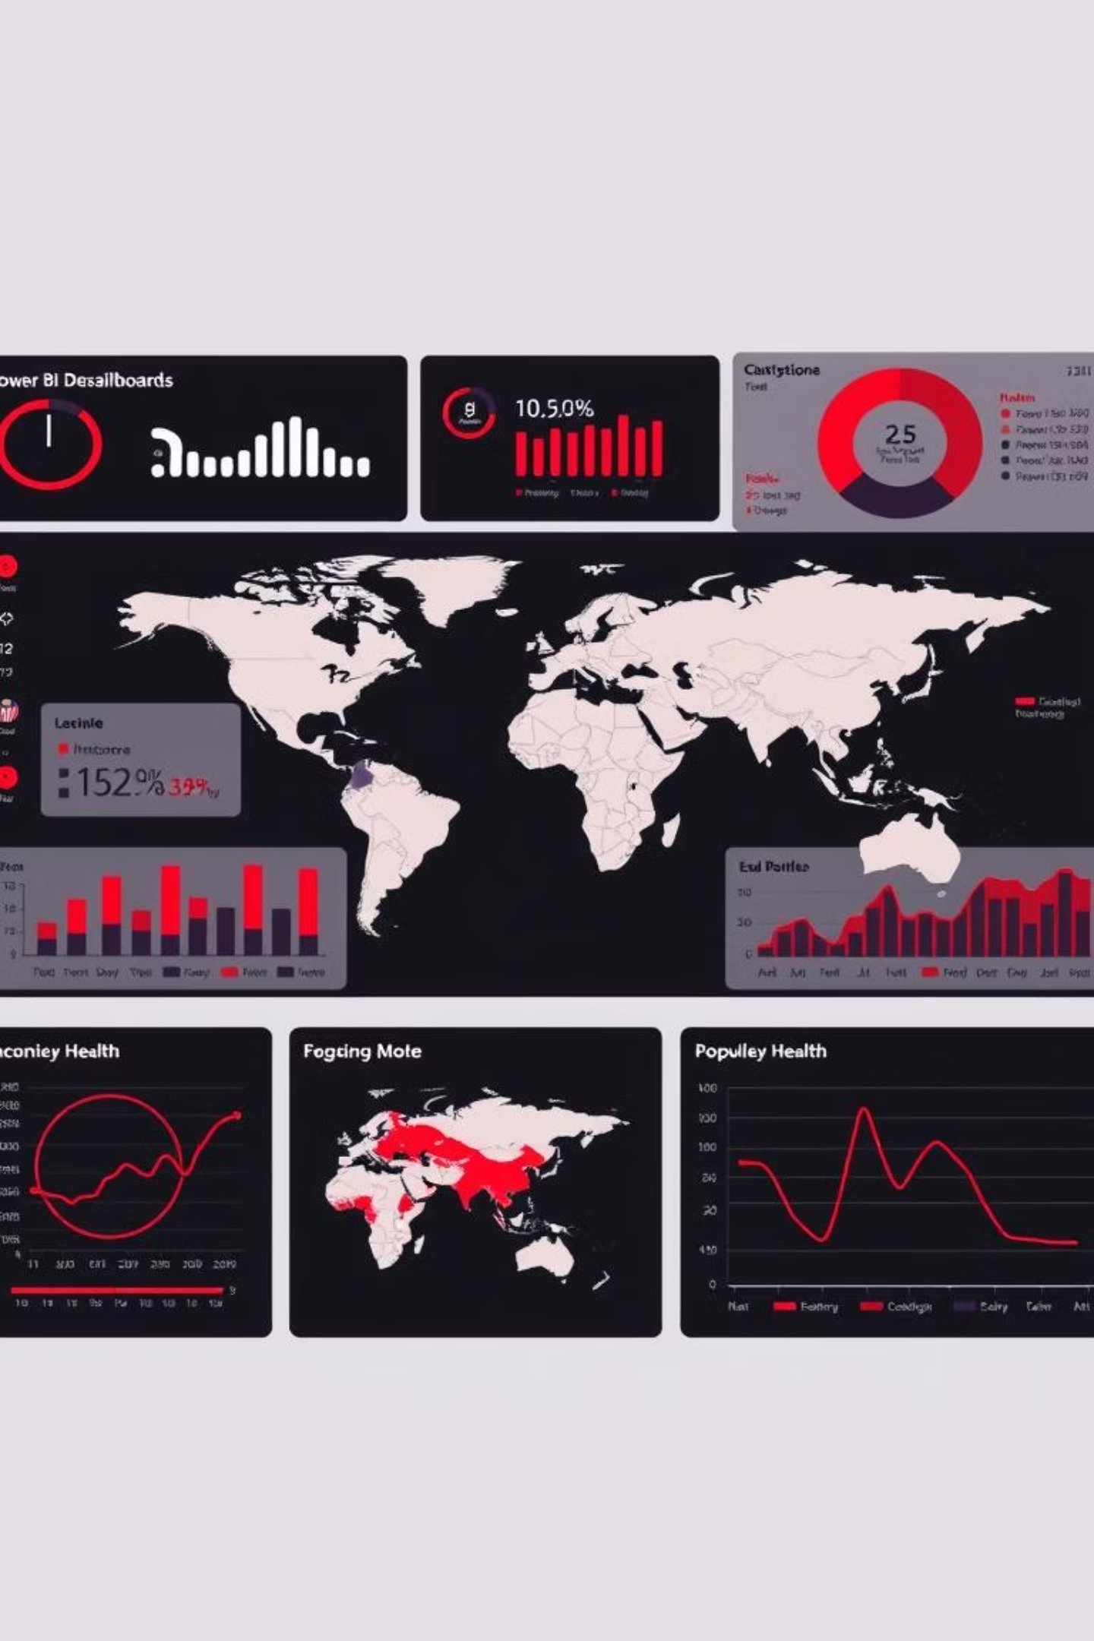
IV. Power BI Dashboard: Visualizing Insights
Interactive Storytelling
Our Power BI dashboard transforms raw data into a dynamic narrative, allowing users to explore global health trends interactively.
Contextual Summaries: Clear explanations of key findings.
Interactivity: Slicers for region/income groups, drill-down to country-specific data.
Visuals: World map with color gradients (life expectancy), scatter plots (income vs. health), bar charts (mortality rates by region).
Design Clarity: Consistent color themes, intuitive navigation, and clear labels.
Innovative Features: DAX formulas for custom metrics (e.g., Health-Adjusted Income Index), AI visuals for outlier detection.

Slide 9
V. Recommendations & Future Work
Actionable Insights & Next Steps
Recommendations
Future Work
Targeted Interventions: Prioritize investments in healthcare infrastructure and education for low-income countries.
Time-Series Analysis: Investigate trends over time to identify causal relationships and the impact of specific events.
Policy Support: Advocate for international policies that promote equitable wealth distribution and health access.
Advanced ML Models: Explore deep learning for more complex pattern recognition.
Data Granularity: Encourage collection of more granular socio-economic and health data at sub-national levels.
Qualitative Data Integration: Incorporate qualitative data (e.g., policy documents, social unrest indicators) for richer context.
Ethical AI: Implement fairness-aware machine learning techniques to mitigate biases in predictions.

Slide 10

Conclusion: A Healthier Future Through Data
This capstone project underscores the profound impact of income on health outcomes globally. By leveraging advanced analytics and interactive visualization, we illuminate critical disparities and provide a foundation for data-driven strategies toward a healthier, more equitable world.

